Slide 1
Data Solutions on Azure
Abdul Rasheed Feroz Khan
Microsoft MVP – Azure

Slide 2
Agenda
HDInsights
Event Hubs
Stream Analytics
Azure Data Lake Store
Azure Databricks
Azure Data Factory
Azure Machine Learning Studio

Slide 3
Azure HDInsight

Slide 4
Azure HDInsight is a fully-managed cloud service that makes it easy, fast, and cost-effective to process massive amounts of data. Use popular open-source frameworks such as Hadoop, Spark, Hive, LLAP, Kafka, Storm, R & more. Azure HDInsight enables a broad range of scenarios such as ETL, Data Warehousing, Machine Learning, IoT and more.

Slide 5
Azure HDInsight
Microsoft Azure’s big-data solution using Hadoop
Open-source framework for storing and analyzing massive amounts of data on clusters built from commodity hardware
Uses Hadoop Distributed File System (HDFS) for storage
Employs the open-source Hortonworks Data Platform implementation of Hadoop
Includes Hive, Pig, Storm, Spark, and more
Integrates with popular BI tools
Includes Power BI, Excel, SSAS, SSRS, Tableau

Slide 6
Apache Hadoop on Azure
Automatic cluster provisioning and configuration
Bypass an otherwise manual-intensive process
Cluster scaling
Change number of nodes without deleting/re-creating the cluster
High availability/reliability
Managed solution - 99.9% SLA
HDInsight includes a secondary head node
Reliable and economical storage
HDFS mapped over Azure Blob Storage
Accessed through “wasb://” protocol prefix

Slide 7
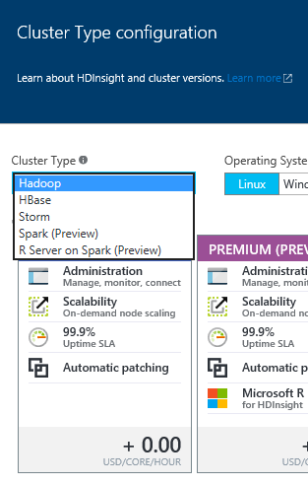
HDInsight Cluster Types
Hadoop: Query workloads
Reliable data storage, simple MapReduce
HBase: NoSQL workloads
Distributed database offering random access to large amounts of data
Apache Storm: Stream workloads
Real-time analysis of moving data streams
Apache Spark: High-performance workloads
In-memory parallel processing

Slide 8
Apache Spark
Interactive manipulation and visualization of data
Scala, Python, and R Interactive Shells
Jupyter Notebook with PySpark (Python) and Spark (Scala) kernels provide in-browser interaction
Unified platform for processing multiple workloads
Real-time processing, Machine Learning, Stream Analytics, Interactive Querying, Graphing
Leverages in-memory processing for really big data
Resilient distributed datasets (RDDs)
APIs for processing large datasets
Up to 100x faster than Hadoop

Slide 9
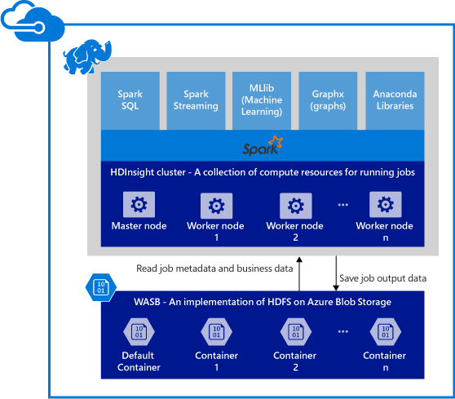
Spark Components on HDInsight
Spark Core
Includes Spark SQL, Spark Streaming, GraphX, and MLlib
Anaconda
Livy
Jupyter Notebooks
ODBC Driver for connecting from BI tools (Power BI, Tableau)

Slide 10
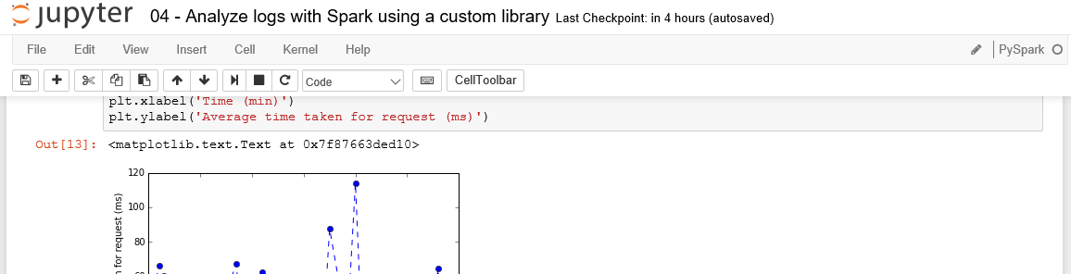
Jupyter Notebooks on HDInsight
Browser-based interface for working with text, code, equations, plots, graphics, and interactive controls in a single document.
Include preset Spark and Hive contexts (sc and sqlContext)

Slide 11
Items of Note About HDInsight
There is no “suspend” on HDInsight clusters
Provision the cluster, do work, then delete the cluster to avoid unnecessary charges
Storage can be decoupled from the cluster and reused across deployments
Can deploy from the portal, but often scripted in practice
Easier/repeatable creation and deletion

Slide 12
Demo

Slide 13
Azure Event Hub

Slide 14
Azure Event Hubs is a hyper-scale telemetry ingestion service which collects, transforms and stores millions of events. As a distributed streaming platform, it gives you low latency and configurable time retention, which enables you to ingress massive amounts of telemetry into the cloud and read the data from multiple applications using publish-subscribe semantics

Slide 15
Azure Event Hub
Highly scalable data streaming platform and event ingestion service, capable of receiving and processing millions of events per second
Process and store events, data, or telemetry produced by distributed software and devices
Data sent to an event hub can be transformed and stored using any real-time analytics provider or batching/storage adapters.
Ability to provide publish-subscribe capabilities with low latency and at massive scale

Slide 16
Why Azure Event Hub ?
Collect more than one million events per second
Send telemetry data automatically to storage
Have a very low latency
Get a managed service with elastic scale
Reach a broad set of platforms using native client libraries
Seamlessly integrate with other Azure services
~$11.00 per month for your Event Hub + $0.028 per million of incoming events
By default events are stored in the Event Hub for one day

Slide 17
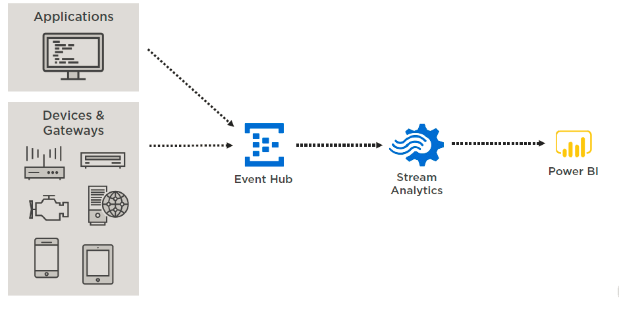
Consume and Analyze Events

Slide 18
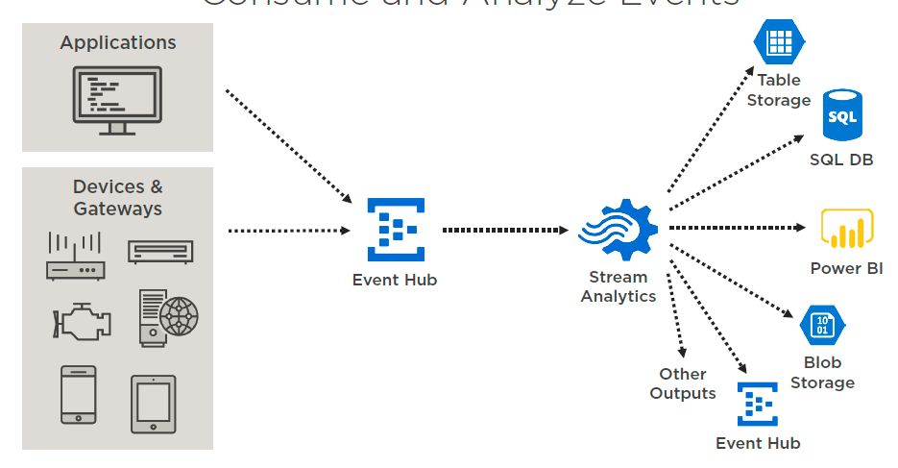
Consume and Analyze Events

Slide 19
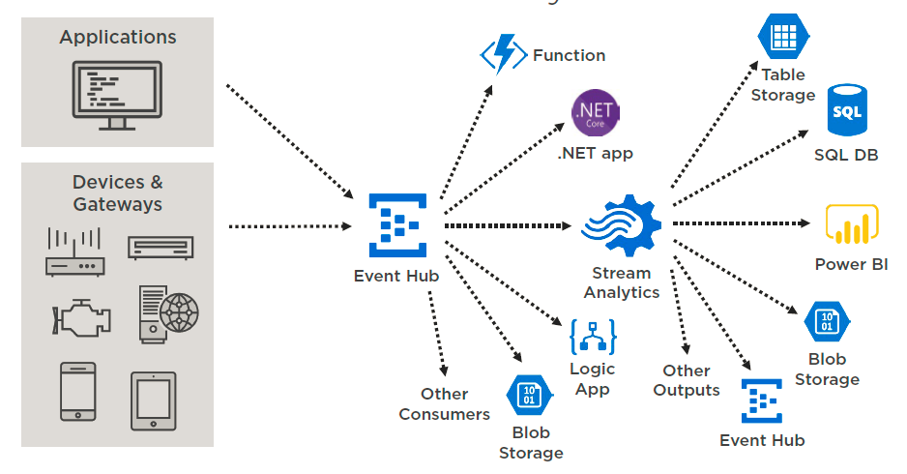
Consume and Analyze Events

Slide 20
Event Hub vs. IoT Hub
 | Event Hub | IoT Hub
Communication | Device to cloud | Device to cloud & cloud to device
Protocols | HTTPS, AMQP | HTTPS, AMQP, MQTT
Concurrent AMQP Connections | 5000 | Optimized for millions of simultaneously connected devices
Device Management | None | Integrated
Authentication | Shared access key | Individual per device

Slide 21
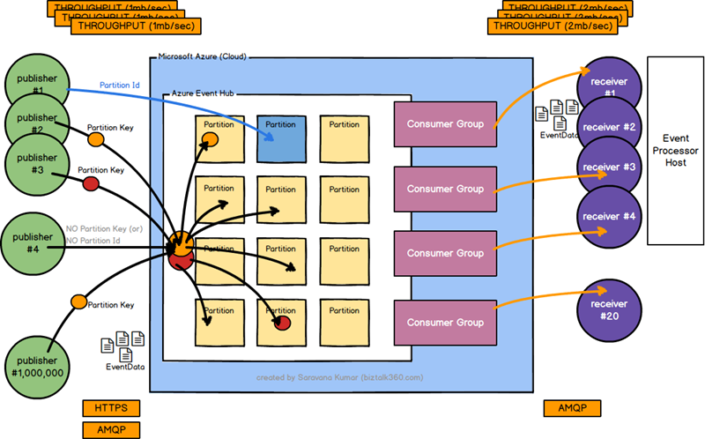
Architecture

Slide 22
Event Hubs - Important terminologies
Event producers/publishers:
An entity that sends data to an event hub. An event is published via AMQP 1.0 or HTTPS
Capture:
Enables you to capture Event Hubs streaming data and store it in an Azure Blob storage account
Partitions:
Enables each consumer to only read a specific subset, or partition, of the event stream
SAS tokens:
Identifies and authenticates the event publisher
Event consumers:
An entity that reads event data from an event hub. Event consumers connect via AMQP 1.0
Consumer groups:
Provides each multiple consuming application with a separate view of the event stream, enabling those consumers to act independently
Throughput units:
Pre-purchased units of capacity. A single partition has a maximum scale of 1 throughput unit

Slide 23
Demo

Slide 24
Azure Stream Analytics

Slide 25
Easily develop and run massively parallel real-time analytics on multiple IoT or non-IoT streams of data using simple SQL like language. Use custom code for advanced scenarios. With no infrastructure to manage, you can process data on-demand, scale instantly and only pay per job.

Slide 26
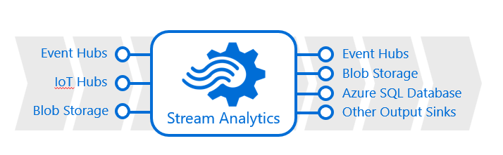
Azure Stream Analytics
Highly scalable service for analyzing data in motion
Supports SQL-like query language for data analysis
Scales using Streaming Units (1 SU ~= 1 MB/sec)

Slide 27
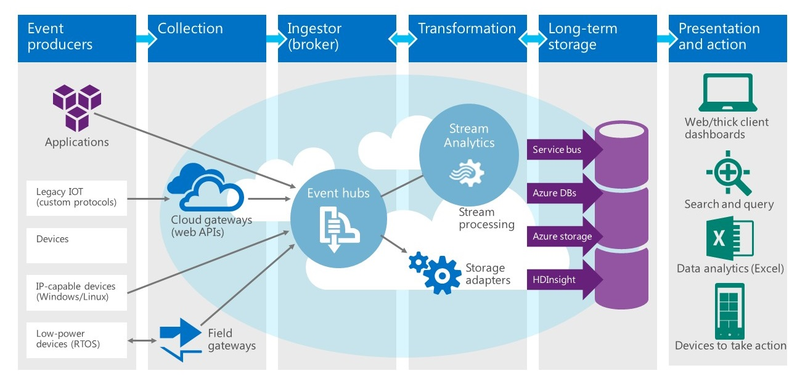
Stream Analytics at Work

Slide 28
Stream Analytics Query Language
SQL-like language for querying live data streams
Subset of T-SQL
Supports bigint, float, nvarchar(max), datetime, record, and array
Supports SELECT, FROM, WHERE, GROUP BY, and other common Data Manipulation Language (DML) statements
Supports COUNT, AVG, DATEDIFF, and other common functions
Adds extensions such as TIMESTAMP BY and System.Timestamp
Supports temporal grouping of events via "windowing"

Slide 29
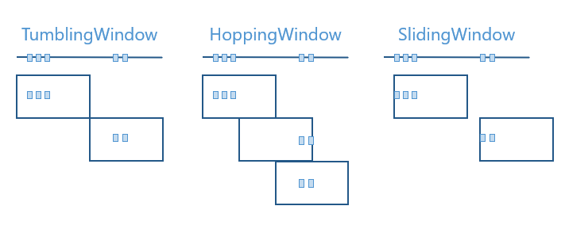
Windowing
Count or aggregate events over a specified time period

Slide 30
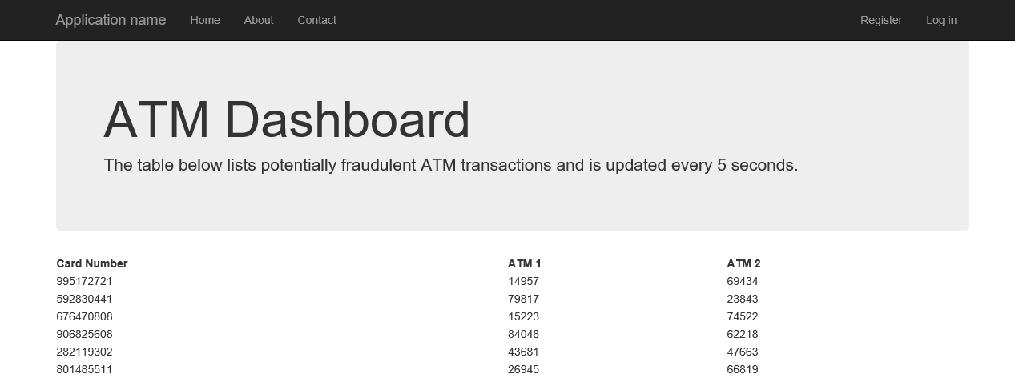
Building Real-Time Dashboards
Direct Stream Analytics output to an Azure event hub
Write code that subscribes to events from the event hub

Slide 31
Demo

Slide 32
Azure Data Lake Store

Slide 33
“A single store of all data… ranging from raw data (which implies exact copy of source system data) to transformed data which is used for various forms including reporting, visualization, analytics, and machine learning”

Slide 34
Azure Databricks
Designed in collaboration with the founders of Apache Spark
One-click set up; streamlined workflows
Interactive workspace that enables collaboration between data scientists, data engineers, and business analysts.
Native integration with Azure services (Power BI, SQL DW, Cosmos DB, Blob Storage)
Enterprise-grade Azure security (Active Directory integration, compliance, enterprise -grade SLAs)

Slide 35
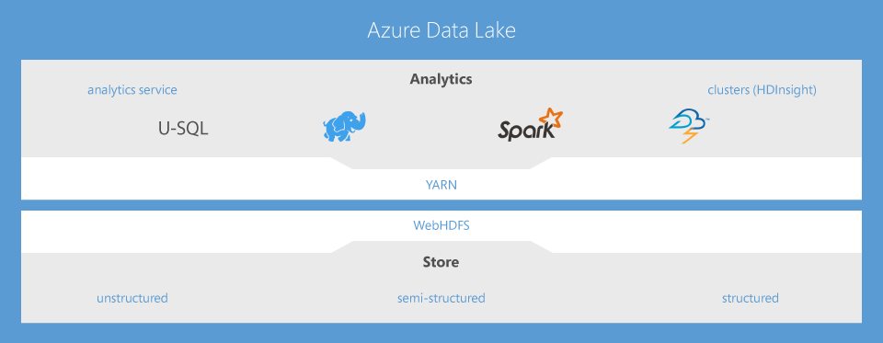
Built on Open-Source

Slide 36
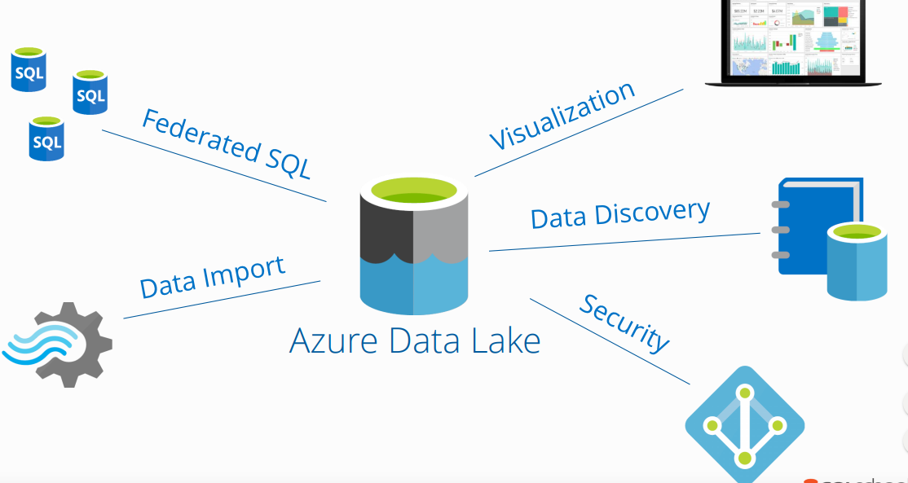
Azure Ecosystem Integration

Slide 37
What Azure Data Lake Offers?
Data Lake Analytics
HDInsight
Data Lake Store
Develop, debug, and optimize big data programs with ease
Integrates seamlessly with your existing IT investments
Store and analyse petabyte-size files and trillions of objects
Affordable and cost effective
Enterprise grade security, auditing, and support

Slide 38
Data Lakes vs Data Warehouses
 | DATA WAREHOUSE | DATA LAKE
DATA | Structured Processed | Structured Semi-structured Unstructured Raw
PROCESSING | Schema-on-Write | Schema-on-Read
STORAGE | Expensive for large data volumes | Designed for low-cost storage
AGILITY | Less Agile Fixed configuration | Highly Agile Configure and Reconfigure as needed
SECURITY | Mature | Maturing

Slide 39
What is Azure Data Lake Store?
Enterprise-wide hyper-scale repository for big data analytic workloads.
Azure Data Lake enables you to capture data of any size, type, and ingestion speed in one single place for operational and exploratory analytics.
Can be accessed from Hadoop (available with HDInsight cluster) using the WebHDFS-compatible REST APIs.
Specifically designed to enable analytics on the stored data and is tuned for performance for data analytics scenarios.
It includes, out of the box, all the enterprise-grade capabilities
security, manageability, scalability, reliability, and availability
Essential for real-world enterprise use cases.

Slide 40
Clusters : Auto-scaling and Auto-termination
Simplifies cluster management and reduces costs by eliminating wastage
When creating Azure Databricks clusters you can choose Autoscaling and Auto Termination options.
Autoscaling: Just specify the min and max number of clusters. Azure Databricks automatically scales up or down based on load.
Auto Termination: After the specified minutes of inactivity the cluster is automatically terminated.

Slide 41
Azure Data Lake Store vs Azure Blob Storage
 | AZURE DATA LAKE STORE | AZURE BLOB STORAGE
PURPOSE | Optimized storage for big data analytics workloads | General purpose object store for a wide variety of storage scenarios
USE CASES | Batch, interactive, streaming analytics and machine learning data such as log files, IoT data, click streams, large datasets | Any type of text or binary data, such as application back end, backup data, media storage for streaming and general purpose data
KEY CONCEPTS | Data Lake Store account contains folders, which in turn contains data stored as files | Storage account has containers, which in turn has data in the form of blobs
STRUCTURE | Hierarchical file system | Object store with flat namespace
SECURITY | Based on Azure Active Directory Identities | Based on shared secrets - Account Access Keys and Shared Access Signature Keys

Slide 42
Azure Data Lake Analytics
Is an on-demand analytics job service to simplify big data analytics.
Focus on writing, running, and managing jobs rather than on operating distributed infrastructure.
Can handle jobs of any scale instantly by setting the dial for how much power you need.
You only pay for your job when it is running, making it cost-effective.
The analytics service supports Azure Active Directory letting you manage access and roles, integrated with your on-premises identity system.

Slide 43
Data Lake Analytics Key Capabilities
Dynamic scaling
Develop faster, debug, and optimize smarter using familiar tools
U-SQL: simple and familiar, powerful, and extensible
Integrates seamlessly with your IT investments
Affordable and cost effective
Works with all your Azure Data

Slide 44
Demo

Slide 45
Azure Databricks

Slide 46
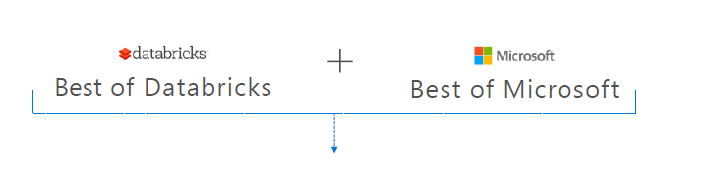
A fast, easy and collaborative Apache® Spark™ based analytics platform optimized for Azure

Slide 47
Azure Databricks
Designed in collaboration with the founders of Apache Spark
One-click set up; streamlined workflows
Interactive workspace that enables collaboration between data scientists, data engineers, and business analysts.
Native integration with Azure services (Power BI, SQL DW, Cosmos DB, Blob Storage)
Enterprise-grade Azure security (Active Directory integration, compliance, enterprise -grade SLAs)

Slide 48
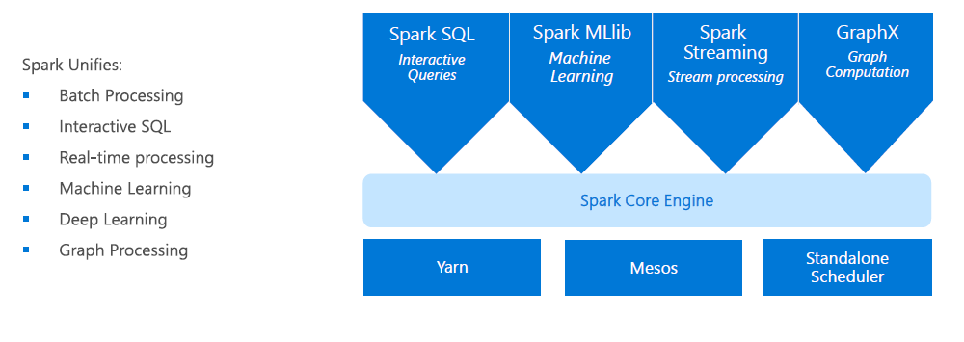
Apache Spark
An unified, open source, parallel, data processing framework for Big Data Analytics

Slide 49
Advantages of a unified platform
Improves developer productivity – a single consistent set of APIs
All different systems in the Spark share the same abstraction
Developers can mix and match different kind of processing in the same application. This is a common requirement for many big data pipelines
Performance improves because unnecessary movement of data across engines is eliminated

Slide 50
Differentiated experience on Azure
Enhance Productivity
Get started quickly by launching your new Spark environment with one click.
Share your insights in powerful ways through rich integration with Power BI.
Improve collaboration amongst your analytics team through a unified workspace.
Innovate faster with native integration with rest of Azure platform
Build on the most compliant cloud
Simplify security and identity control with built-in integration with Active Directory.
Regulate access with fine-grained user permissions to Azure Databricks’ notebooks, clusters, jobs and data.
Build with confidence on the trusted cloud backed by unmatched support, compliance and SLAs.
Scale without limits
Operate at massive scale without limits globally.
Accelerate data processing with the fastest Spark engine.

Slide 51
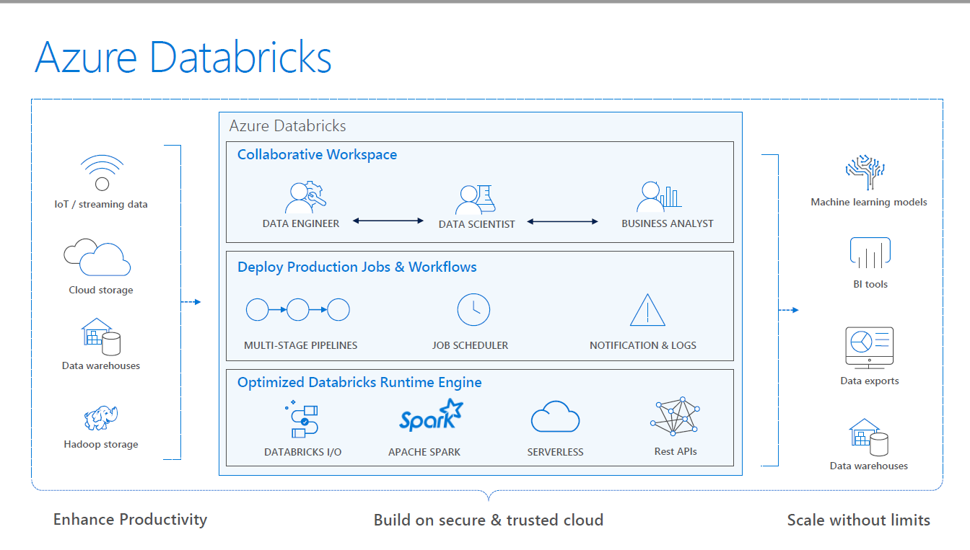

Slide 52
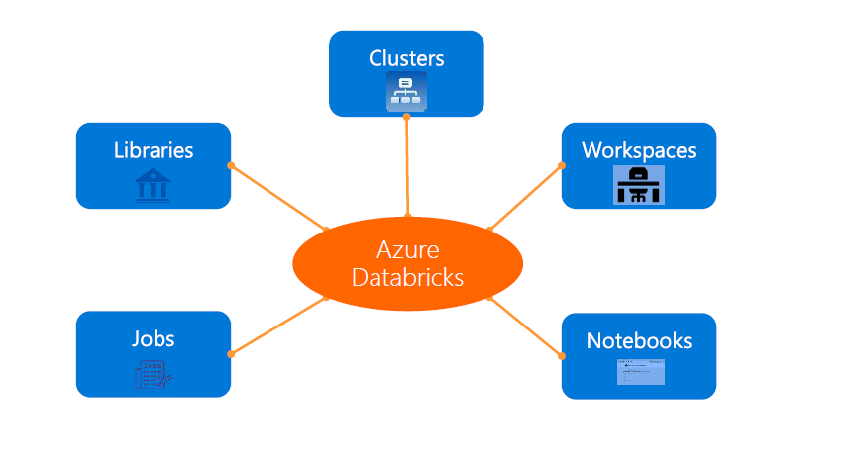
Azure Databricks Core Artifacts

Slide 53
Integration with AAD
There is no need to define users—and their access control—separately in Databricks.
AAD users can be used directly in Azure Databricks for all user-based access control (Clusters, Jobs, Notebooks etc.).
Databricks has delegated user authentication to AAD enabling single-sign on (SSO) and unified authentication.
Notebooks, and their outputs, are stored in the Databricks account. However, AADbased access-control ensures that only authorized users can access them.

Slide 54
Clusters : Auto-scaling and Auto-termination
Simplifies cluster management and reduces costs by eliminating wastage
When creating Azure Databricks clusters you can choose Autoscaling and Auto Termination options.
Autoscaling: Just specify the min and max number of clusters. Azure Databricks automatically scales up or down based on load.
Auto Termination: After the specified minutes of inactivity the cluster is automatically terminated.

Slide 55
Jobs
Jobs are the mechanism to submit Spark application code for execution on the Databricks clusters
Spark application code is submitted as a ‘Job’ for execution on Azure Databricks clusters
Jobs execute either ‘Notebooks’ or ‘Jars’
Azure Databricks provide a comprehensive set of graphical tools to create, manage and monitor Jobs.

Slide 56
Workspaces
Workspaces enables users to organize—and share—their Notebooks, Libraries and Dashboards
Everything in a workspace is ordered into hierarchical folders
Fine grained access controls can be defined in workspaces to enable secure collaboration among collegues

Slide 57
Notebooks
Notebooks are not only for authoring Spark applications but can be run/executed directly on clusters
Shift+Enter
Notebooks support fine grained permissions—so they can be securely shared with colleagues for collaboration (see following slide for details on permissions and abilities)
Notebooks are well-suited for prototyping, rapid development, exploration, discovery and iterative development

Slide 58
Visualization
All notebooks, regardless of their language, support Databricks visualizations.
When you run the notebook the visualizations are rendered inside the notebook in-place
The visualizations are written in HTML.
You can save the HTML of the entire notebook by exporting to HTML.
If you use Matplotlib, the plots are rendered as images so you can just right click and download the image
You can change the plot type just by picking from the selection

Slide 59
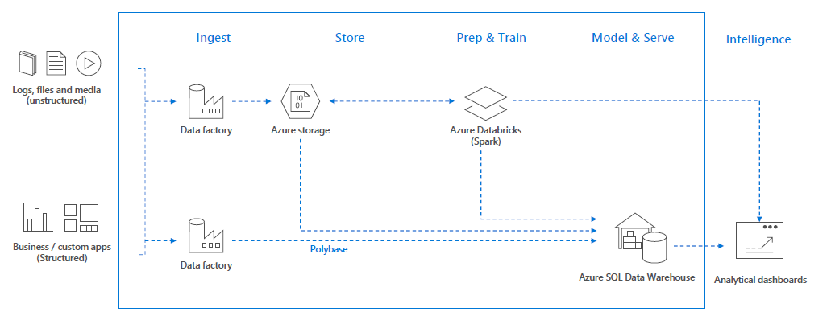
Use cases – Modern Big Data Warehouse

Slide 60
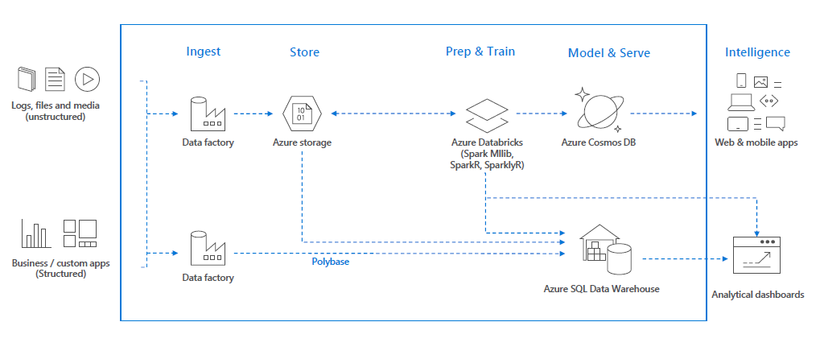
Use cases – Advanced Analytics on Big Data

Slide 61
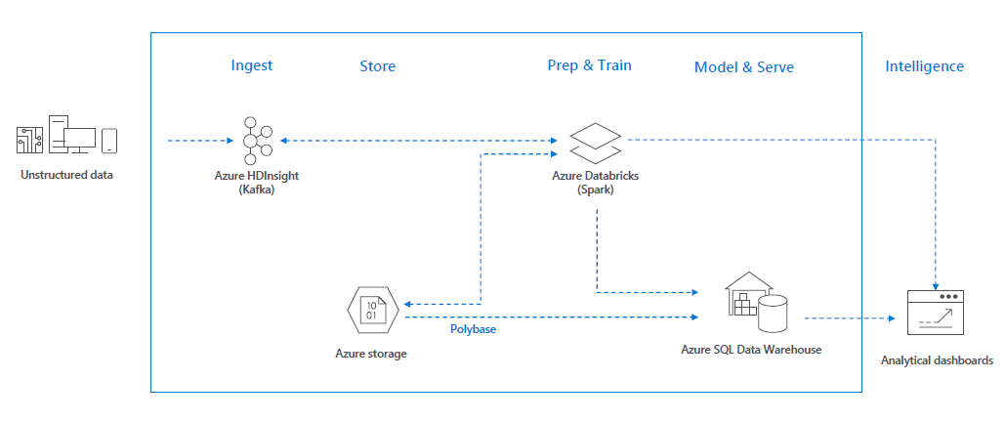
Use cases – Real-time analytics on Big Data

Slide 62
Demo

Slide 63
Azure Data Factory

Slide 64
Azure Data Factory is a cloud service that orchestrates, manages, and monitors the integration and transformation of structured and unstructured data from on-premises and cloud sources at scale.

Slide 65
Hybrid data integration at scale, made easy
Hybrid data integration at scale, made easy
Create, schedule and monitor data pipelines
Fully managed ETL service in the cloud
Run your SQL Server Integration Services packages directly in Azure
Accelerate your data integration with multiple native data connectors
Modernise your data warehouse with big data integration
Orchestrate your data integration workflows wherever your data lives

Slide 66
Why Azure Data Factory?
Productive
Build automated data integration solutions with a visual drag-and-drop UI. Move data seamlessly from over 60 sources without writing code.
Hybrid
Build data integration pipelines which span on-premises and cloud. Easily lift your SQL Server Integration Services (SSIS) packages to Azure.
Trusted
Data movement using Azure Data Factory has been certified by HIPAA/HITECH, ISO/IEC 27001, ISO/IEC 27018 and CSA STAR.
Scalable
Build serverless, cloud-based data integration with no infrastructure to manage. Take advantage of elastic capabilities to scale out with your customer growth.

Slide 67
What comes with Azure Data Factory?
Visual drag-and-drop UI
Maximise productivity by getting pipelines up and running quickly.
Use the code-free drag-&-drop interface to build, deploy, monitor and manage your data integration.
Connect this visual tool directly to your Git repository for a seamless development workflow.
Multiple Language Support
Use the visual interface or write your own code in Python, .NET, or ARM to build pipelines using your existing skills.
Choose from a wide range of processing services and put them into managed data pipelines to use the best tool for the job or insert custom code as a processing step in any pipeline.

Slide 68
What comes with Azure Data Factory?
SSIS package execution in Azure
Easily execute and schedule your SSIS packages in managed execution environment.
Gain high availability, scalability and lower TCO by lifting your SSIS packages to Azure.
Code-free data movement
Improve your TCO with more than 70 natively supported connectors including Azure data services, AWS S3 and Redshift, Google BigQuery, SAP HANA, Oracle, DB2, MongoDB and many more across multiple global points of presence.
Comprehensive control flow
Facilitate looping, branching, conditional constructs, on-demand executions and flexible scheduling with extensive control flow constructs.

Slide 69
Data Factory Components
Linked Servers
SQL Server Database – PaaS, IaaS, On Premise
Azure Storage – Blob, Table
Datasets
Input/Output using JSON deployed with PowerShell
Pipelines
Activities using JSON deployed with PowerShell
Copy, HDInsight, Azure Machine Learning

Slide 70
Data integration with Azure Data Factory
Step 1: Access and ingest data with built-in connectors
Move data from on-premises and cloud sources to a centralised data store in the cloud for further analysis by using the Copy Data activity in a data pipeline.
Step 2: Build scalable data flow with codeless UI, or write your own code
Build data integration and easily transform and integrate big data processing and machine learning with the visual interface.
Step 3: Schedule, run and monitor your pipelines
Invoke pipelines with on-demand and trigger-based scheduling. Visually monitor pipeline activity with logging and pipeline history and track error sources.

Slide 71
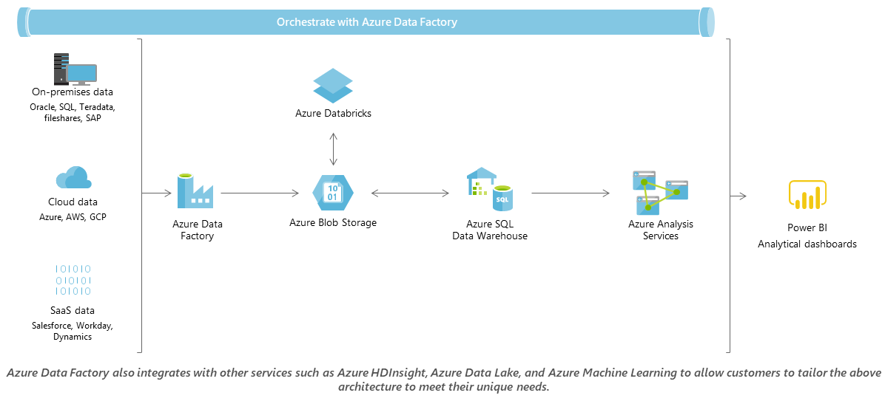
Modernize your data warehouse

Slide 72
Demo

Slide 73
Machine Learning Studio

Slide 74
Azure Machine Learning Studio is a powerfully simple browser-based, visual drag-and-drop authoring environment where no coding is necessary. Go from idea to deployment in a matter of clicks.

Slide 75
What is machine learning?
Machine learning (ML) enables computers to learn from data and experiences and to act without being explicitly programmed.
Azure Machine Learning is a cloud predictive analytics service that makes it possible to quickly create and deploy predictive models as analytics solutions.
With ML Studio you can build Artificial Intelligence (AI) applications that intelligently sense, process, and act on information - augmenting human capabilities, increasing speed and efficiency, and helping organizations achieve more.

Slide 76
Microsoft Azure Machine Learning Studio
A fully-managed cloud service that enables you to easily build, deploy, and share predictive analytics solutions.
Collaborative, drag-and-drop tool you can use to build, test, and deploy predictive analytics solutions on your data.
ML Studio publishes models as web services that can easily be consumed by custom apps or BI tools such as Excel.

Slide 77
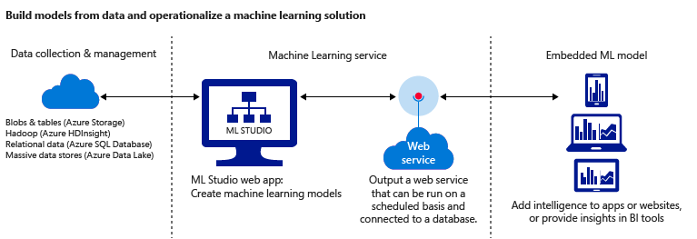
Microsoft Azure Machine Learning Studio

Slide 78
Five steps to create an experiment
Before you start:
Open Machine Learning Studio: https://studio.azureml.net and Sign In.
If you’ve signed into Machine Learning Studio before, click Sign In.
Otherwise, click Sign up here and choose between free and paid options.
Create a model
Step 1: Get data
Step 2: Prepare the data
Step 3: Define features
Train the model
Step 4: Choose and apply a learning algorithm
Score and test the model
Step 5: Predict new automobile prices

Slide 79
Demo

